Slide 1
Lab4 CUDA Advance
Nov, 2024 Parallel Programming

Slide 2
Overview
Techniques that can further optimize a CUDA program
Coalesced Memory Access
Lower Precision
Shared Memory
Multiple Blocks
Lab4

Slide 3
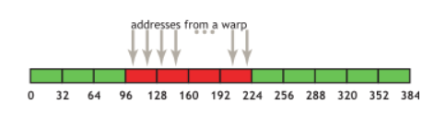
Coalesced Memory Access
In short,
Concurrent memory accesses in a warp should be continuous
Why
GPU has L2 (32 bytes), L1 (128 bytes) cache
If memory accesses in a warp are continuous, it can
merge memory requests from all threads into a single memory request
utilize the cache
Details
CUDA Best Practices

Slide 4
Access without Coalesced Memory
If each thread compute a single row -> Failed to combine requests into one request
Iter 1
Iter 2
Iter N
threadIdx.x = 0
The view of an
image
B | G | R | B | G | R | … | B | G | R
B | G | R | B | G | R | … | B | G | R
B | G | R | B | G | R | … | B | G | R
B | G | R | B | G | R | … | B | G | R
threadIdx.x = 1
threadIdx.x = 2
threadIdx.x = 3
The view of an memory access pattern
(N-1) x 3 - 2
B | G | R |  |  | B | G | R |  |  | B | G | R |  |  | B | G | R

Slide 5
Coalesced Memory Access
The accesses can be combined into a single request if we change the access pattern
The view of an
image
threadIdx.x = 0
Iter 1
B | G | R | B | G | R | B | G | R | B | G | R
B | G | R | B | G | R | B | G | R | B | G | R
B | G | R | B | G | R | B | G | R | B | G | R
Iter 2
threadIdx.x = 1
…..
threadIdx.x = 2
Iter N
threadIdx.x = 3
The view of an memory access pattern
Threads in the same warp
3 bytes * 32 threads = 96 bytes
B | G | R | B | G | R | B | G | R | B | G | R

Slide 6
Mixed-Precision
Lower the precision of variables could reduce the computing time and also the computing accuracy
Try to
Use float to replace double
Use fp16 to replace float
Make sure using lower precision does not corrupt the results

Slide 7
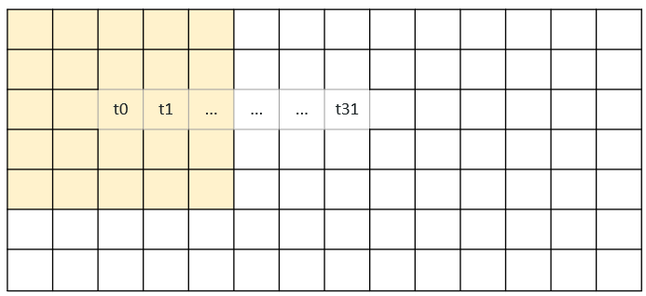
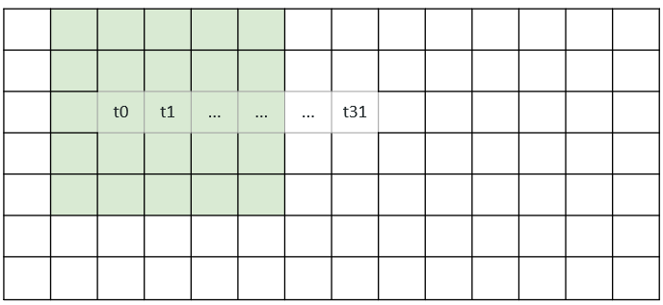
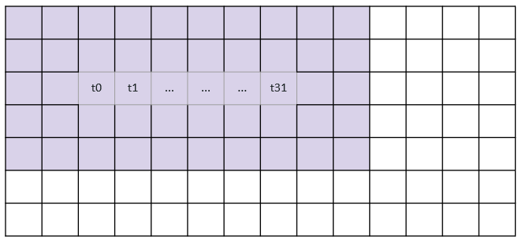
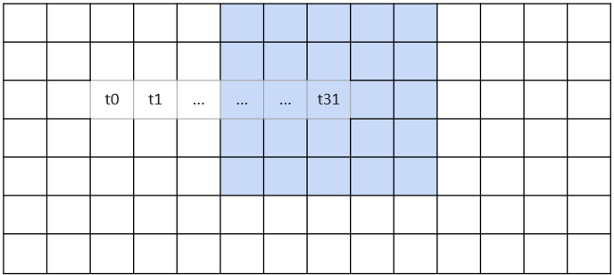
Shared Memory
Shared memory can greatly reduce the access time of a reused data item
Required data by t0
Required data by t1
Required data by t31
Shared data by t0 ~ t31

Slide 8
Using Shared Memory in Sobel
Move the required data into shared memory
Compute
Update shared memory
 |  | t0 | t1 | ... | ... | ... | t31

Slide 9
Multiple Blocks
The number of threads per block is limited comparing to the number of blocks per grid.
Therefore, we can launch more blocks for the higher level of parallelism
E.g., Break the computation into multiple blocks with the size of 32 x 32
Denoting the x, y coordinate of a pixel by threadIdx and blockIdx
E.g., int x=blockIdx*blockDim+threadIdx;
Hint: you should choose the right indexing method to ensure coalesced memory access

Slide 10
Lab4
Optimize the sobel operator with the following
Coalesced Memory
Lower Precision
Shared Memory
TAs provided a sample CUDA program
optimize it to be at least 13x faster
Materials : /home/pp24/share/lab-sobel/sobel.basic.cu
Name your kernel as “sobel_opt.cu”
We accept little pixel errors

Slide 11
Submission
Finish it before 11/7 23:59
Submit your code and Makefile (optional) to eeclass
You can use lab-sobel-opt-judge for pre-check

